Slide 1


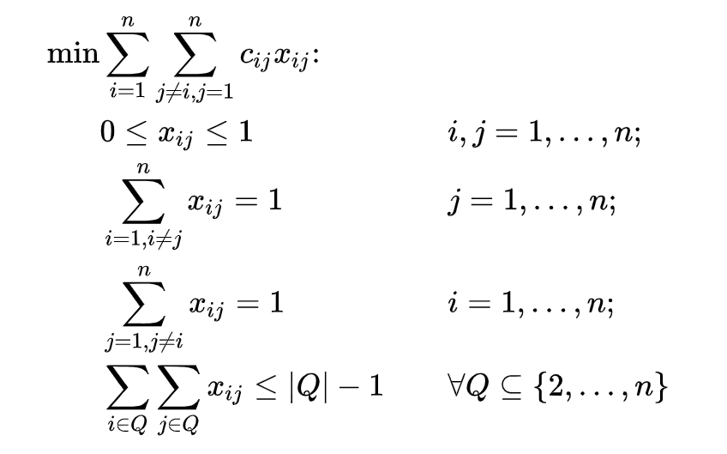
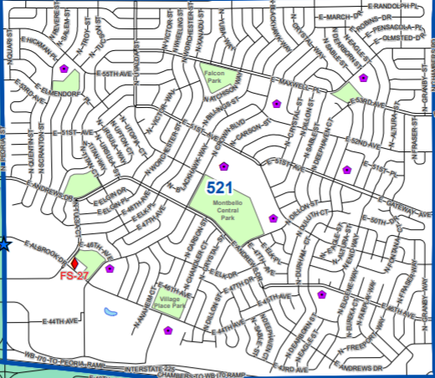
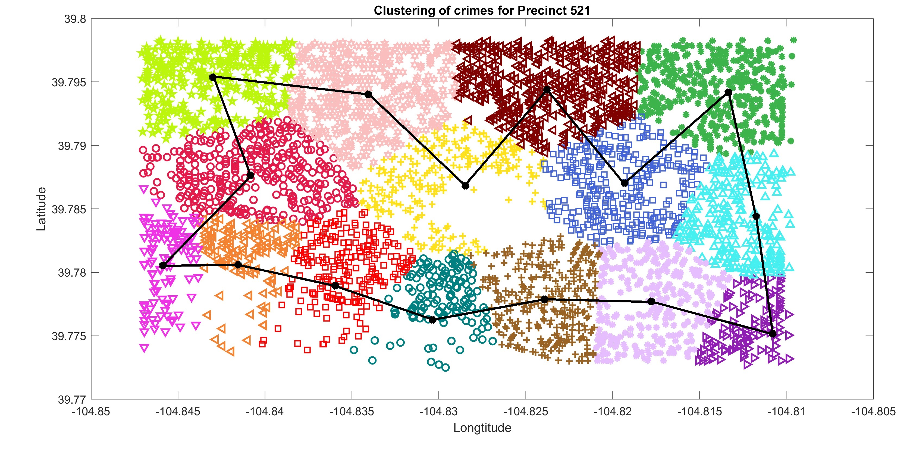
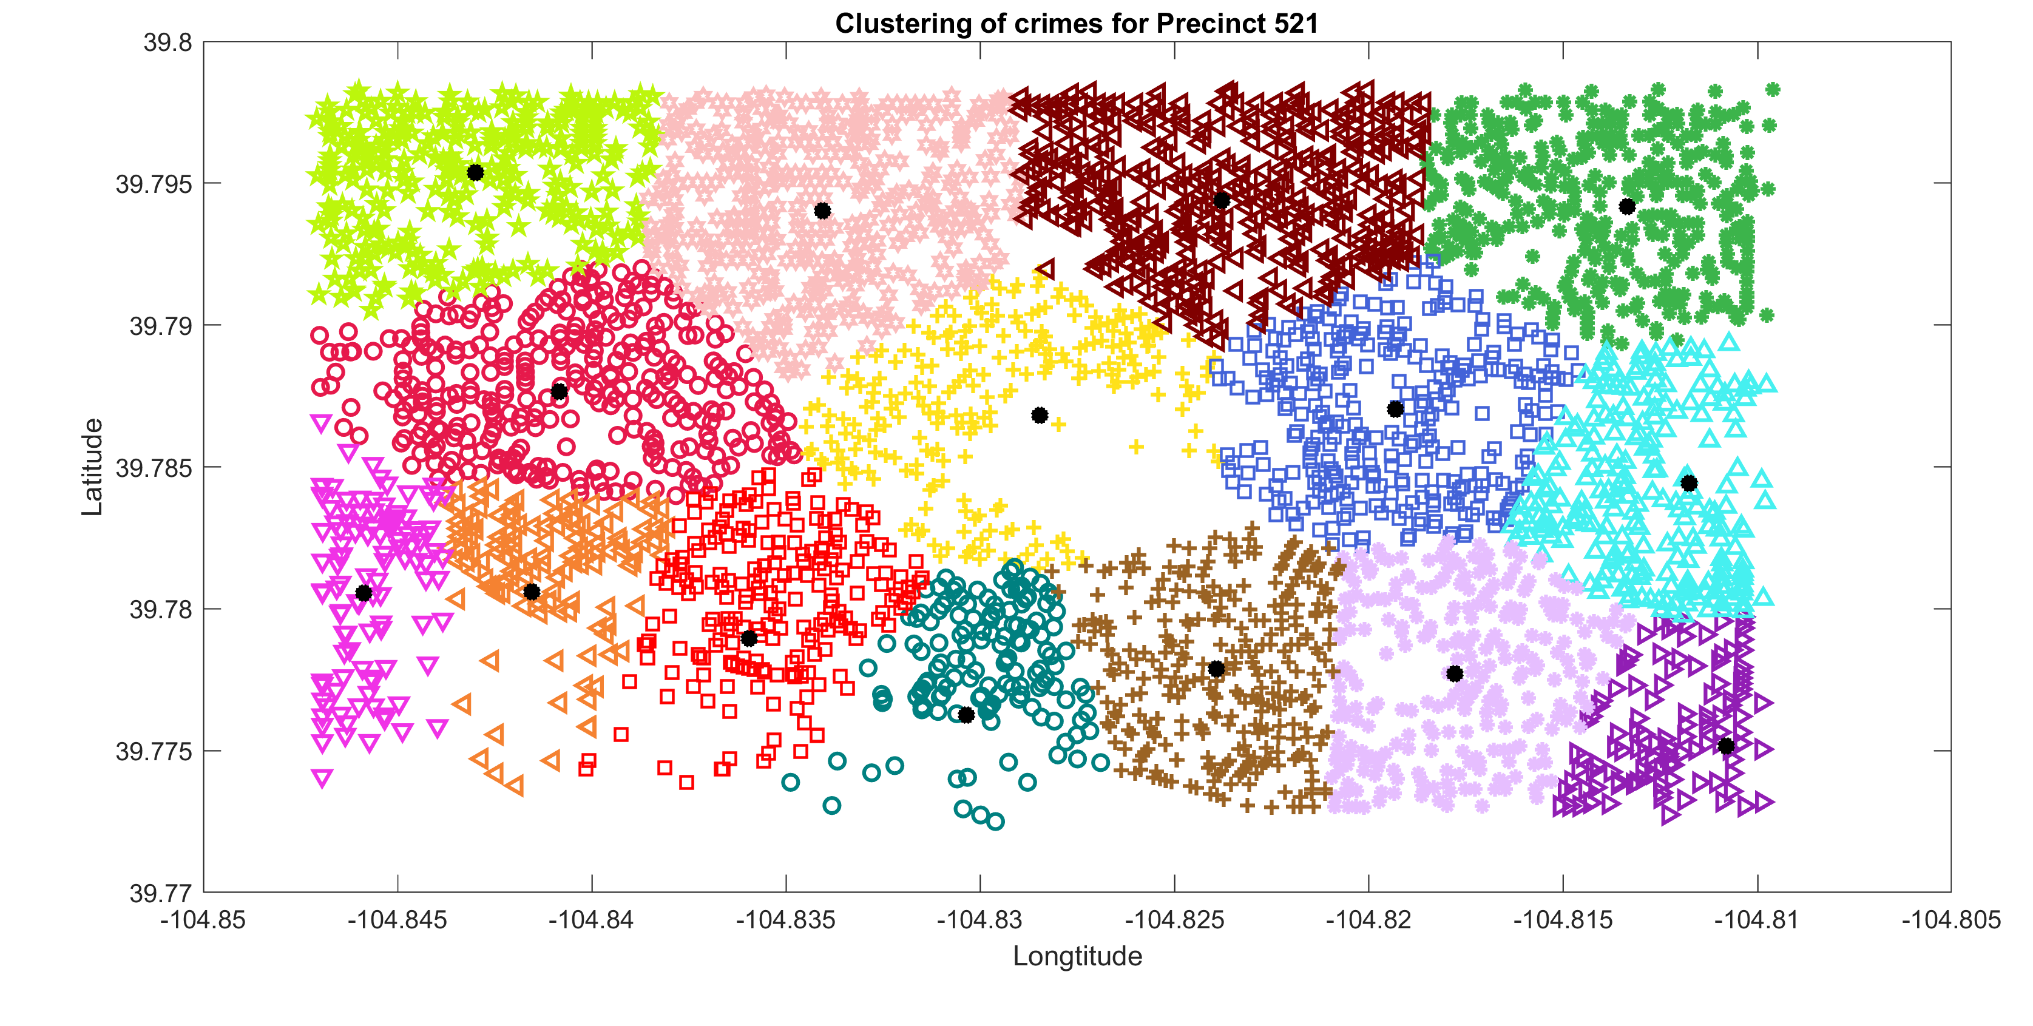
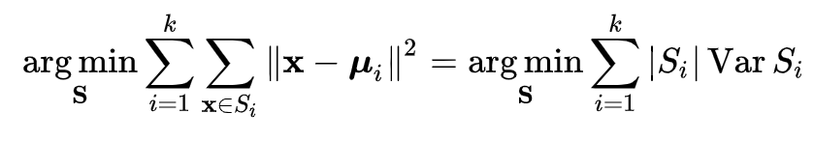
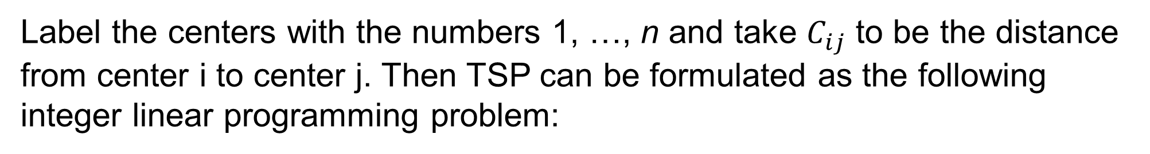
MATH 7594: Integer Programming Professor: Steffen Borgwardt
Optimizing the Patrolling Route
DONGDONG LU
Question: How to design the best patrolling route for a police vehicle in Precinct 521?
Plugging the above results in to the Integer Programming model to solve for the best patrolling route:
Results after clustering the crime point into 15 regions, and calculated the geometric center for each of them. We get the following graph:
Introduction
Optimizing the patrolling route for a police car is a strategy which we can apply to improve policing. By analyzing historical crime data, we can identify which locations would benefit the most using optimized patrolling routes. Using graph theory, we model those locations as vertices in a graph. Determining an optimized patrolling route can then be solved as a classical Travelling Salesman Problem (TSP).
Policy Proposal & Further thinking
For a more efficient policing, we can use K-means clustering technique to construct to precincts.
Among those precincts, the above analysis would help design better patrolling routes.
Divide the crime data into day time crimes and night time crimes and types, the above procedures may produce different patrolling routes and reveal new information on the distribution patterns of certain types of crimes.
K-means Clustering
Given a set of data points (x₁, x₂, …, x_{n}), k-means clustering is a method to partition the n data points into k (≤ n) sets S = {S₁, S₂, …, S_{k}}, which minimize the within-cluster sum of squares. In formula, the objective is to calculate:
TSP Model
Label the centers with the numbers 1, …, n and take $C_{ij}$ to be the distance from center i to center j. Then TSP can be formulated as the following integer linear programming problem:
Acknowledgement
The project is finished under the kind instruction of Dr. Borgwardt and generous assistance of Mr. Bin She.
The reference will be attached at UC Denver Optimization wiki page.

